Slide 1
Real Estate (File structure mini project)

Slide 2



OBJECTIVE
1
To build a unique collaborative platform
2
Acknowledge
3
Reduce the latency and work load while searching an apartment

Slide 3


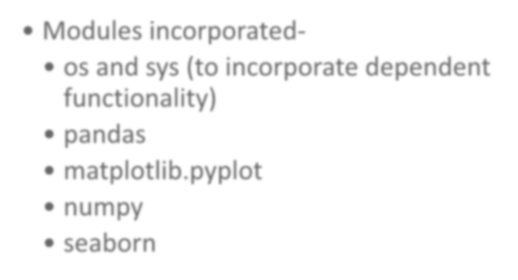
Languages and packages used while implementing the platform .
Language used- Python (Version 3.x/2.7)
Modules incorporated-
os and sys (to incorporate dependent functionality)
pandas
matplotlib.pyplot
numpy
seaborn

Slide 4





REQUIREMENT
Version Control (Git)
Text Editor - Atom/sublime
OS-
Linux/windows

Slide 5

How we managed to do our project remotely ?
We used Git. With this powerful tool, we managed our code, commits, could save our project from catastrophically silly mistakes!
GitHub is a Web-based Git version
control repository hosting service.
BOOM !!!
It’s open source ………….

Slide 6
Let’s dive into
demo

Slide 7

Start screen

Slide 8



FUNCTIONAL UTILITIES
1 2 3
4
5
1) Insertion - This functionality helps in inserting details which are related to the apartments/estates. These details include the
apartment’s name, size,
price, owner’s information, condition, etc. Each of the details are explicitly added which are stored in a file
2) Searching - This functionality helps the user in searching for an apartment according to the field entered. The search can be done according to different parameters entered by the user.
3) Modifying - This functionality helps in making changes to the added apartments. The user can change the apartment details such as name, price, condition, size, owner’s name, etc.
4) Deletion-Select a particular record and delete it.
5) Visualizing – This functionality help in visualizing the data based on different parameters. This is done in the form of graphical representations for better understanding.

Slide 9
METHOD USED : INDEXING
Why indexing ?
Data is usually stored in random order in hard disk . In order to search for a data , we will require to do sequential searching which takes a lot of time .
For sorting all the data , we need to put them all in the main memory . This is practically not possible as data in main memory will usually be way smaller than the amount of data in the hard disk . Therefore we use indexing .
By using indexing , we reduce the time complexity from O(n)
to log n .

Slide 10

Indexing Used in Our Portal
Type of Indexing Used?
Primary indexing is the methodology which has been used in this proposed project. The name of the estate is been chosen as the primary index field according to which the primary index fields are sorted in the index files.
The majority of the functionalities in the proposed project like searching, deletion and modification are done with the help of this sorted index file.

Slide 11
What’s interesting in our portal ?
Data analytics and visualisation-
Data analytics and visualisation can create a huge impact in the business of real estate. The project has a miniature version of the same. We have implemented analytics with the raw data sets available on Kaggle and Gov.in.
Implementation-
Fire up the console and run the estate.py script

Slide 12
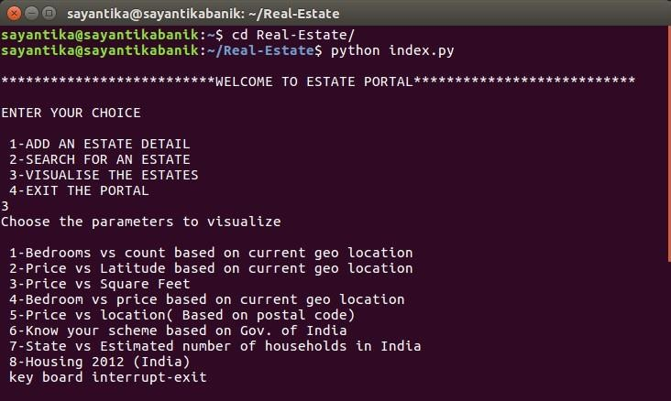
SELECT THE OPTION-

Slide 13
FUTURE ENHANCEMENT
Enhancing the portal to incorporate higher order algorithms (Hashing/ Dynamic Hashing)
Scaling the portal with GUI.
Storing the data sets directly into cloud providing centralized availability

Slide 14






Slide 15
THANK YOU

